Slide 1
Rapid Plan Adaptation Through Offline Analysis of Potential Plan Disruptors
Robert H. Holder, III
Dissertation Defense
December 9, 2015
Committee:
Dr. Marie desJardins, Chair
Dr. Tim Finin, Co-Chair
Dr. Tim Oates
Dr. R. Scott Cost
Dr. Don Miner

Slide 2
Outline
Motivation
Related Work
Approach
Algorithms
Experiments
TSP
Knapsack
Elevator
Offline Time Investment
Conclusions

Slide 3
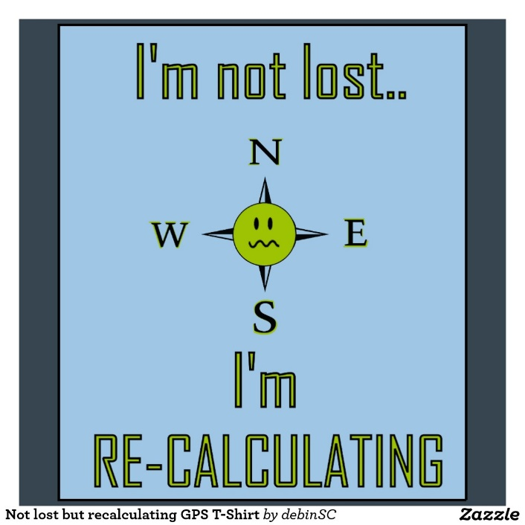
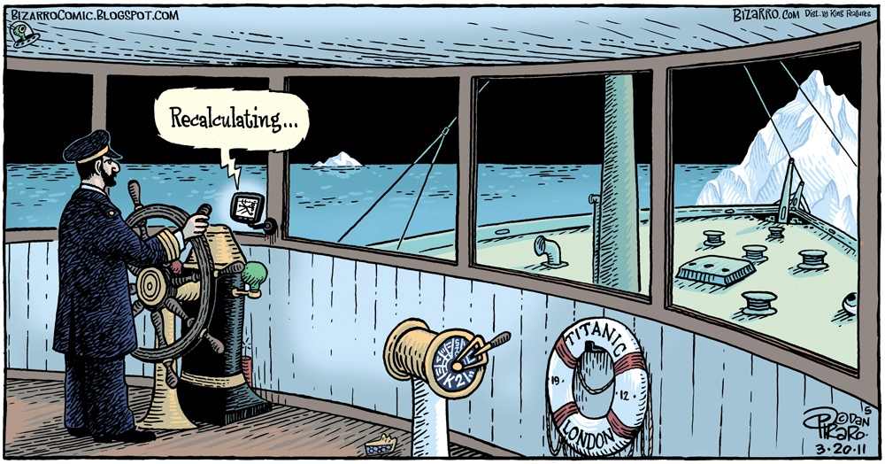
Motivation
http://www.zazzle.com/not_lost_but_recalculating_gps_t_shirt-235701719876135680
http://blueskygis.blogspot.com/2011/03/titanic-recalculation.html

Slide 4
Motivation
Real-time Planning Problems
Shipboard Computing Resource Allocation
Mobile Sensor Scheduling
Unmanned Vehicle Routing
Wireless Sensor Network (WSN) Reconfiguration

Slide 5
Dynamic Vehicle Routing Problem
Three vehicles to visit twelve destinations

Slide 6
Dynamic Vehicle Routing Problem
Static solution for known destinations

Slide 7
Dynamic Vehicle Routing Problem
Consideration for potential additional destination
Notes:
Anything could happen. A vehicle could break down, a customer could cancel, or, as in this example, a new destination could become necessary

Slide 8
Dynamic Vehicle Routing Problem
X
X
X
Contingency solution for additional destination

Slide 9
Dynamic Vehicle Routing Problem
Implementation of contingency solution

Slide 10
Dynamic Vehicle Routing Problem
How to plan contingencies for arbitrary possibilities?

Slide 11
Overview
Problem
Reduce reaction time of real-time planners to changes in the environment
Approach
Preplanned libraries as alternative to traditional online plan repair
Leverage larger amount of offline time to save small amount of online time

Slide 12
Contributions
Representation framework to model and reason about the topological structure of the solutions of related plans
Novel algorithms that exploit solution space structure to generate plan libraries
Techniques to manipulate the structure of the solution space to be favorable for approximation algorithms
Algorithm evaluation by comparison to competing techniques for a set of sample problems

Slide 13
Outline
Motivation
Related Work
Approach
Algorithms
Experiments
TSP
Knapsack
Elevator
Offline Time Investment
Conclusions

Slide 14
Related Work – Technique Comparison
Plan Library Generation
case-based reasoning (created after runtime)
reactive planning (subset of input, localized)
conditional & contingency planning (localized)
decision-theoretic (relies on probabilities)
Real-time Planning
plan repair (runtime, works for small changes)
anytime & contract algorithms (runtime)

Slide 15
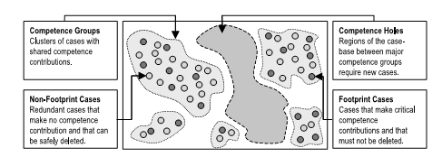
Related Work – Case-Based Reasoning
Smyth & McKenna (2001)

Slide 16
Related Work – Domain Space Analysis
Plan Library Generation – post hoc, partial plans
Bulka (2009) – Backbone planning
Kondaris (2008) – Automated skill learning
Real-time Planning – probabilistic adaptation
Burns, et. al. (2012) – Anticipatory online planning
Notes:
State space analysis – previous states or problem instances inform subsequent problem instances
Library generation – storing previous results to help with subsequent problems
Solution space analysis – reasoning about problem instances based on solutions

Slide 17
Related Work – Domain Space Analysis (2)
Solution Space Analysis – solution evaluation
Miner (2009) – Solution gradient lines
Rosen, et. al. (2005) – Medical plan comparison
Gopal & Starkschall (2002) – Medical plan topology
State Space Analysis – leverage solved problems
Domshlak, et. al. (2010) – Mapping state to best heuristic
Boyan & Moore (2000) – Estimate best initial search state

Slide 18
Outline
Motivation
Related Work
Approach
Algorithms
Experiments
TSP
Knapsack
Elevator
Offline Time Investment
Conclusions

Slide 19
Traveling Salesman Problem (TSP)
4
2
1
3
Four fixed cities
Central starting point
Unknown fifth city
Minimize distance to travel to all cities

Slide 20
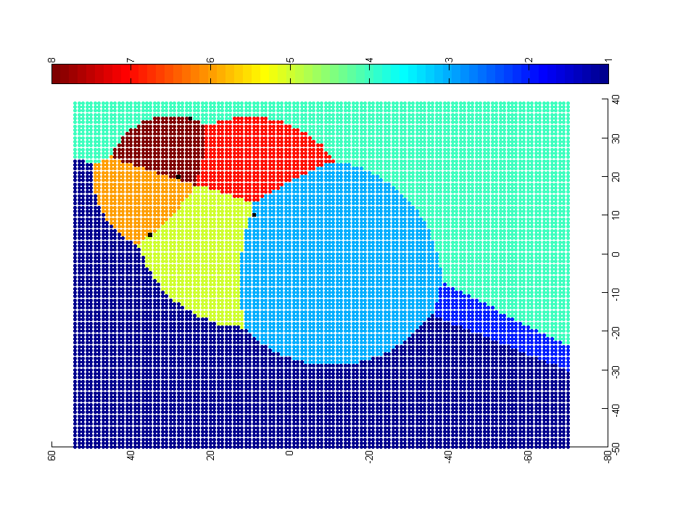
Approach: Problem-Solution Map
4
0-1-3-2-5-4
0-1-5-4-2-3
0-1-3-2-4-5
2
1
0-1-3-5-2-4
3
0-1-5-3-2-4
0-5-1-3-2-4
0-3-2-4-1-5
0-1-4-2-3-5
Each point represents a potential location of the fifth city. The color of the point represents the optimal solution for the resulting 5-city TSP.

Slide 21
Outline
Motivation
Related Work
Approach
Algorithms
Experiments
TSP
Knapsack
Elevator
Offline Time Investment
Conclusions
Sampling+Classification (SC)
SC+Bias
SC+Active Learning (SC+AL)
Solution Border Estimation (SBE)
Support Vector Machine (SVM)
SVM+SBE
Select from Sampled Solutions (SSS)

Slide 22
Outline
Motivation
Related Work
Approach
Algorithms
Experiments
TSP
Knapsack
Elevator
Offline Time Investment
Conclusions
Sampling+Classification (SC)
SC+Bias
SC+Active Learning (SC+AL)
Solution Border Estimation (SBE)
Support Vector Machine (SVM)
SVM+SBE
Select from Sampled Solutions (SSS)

Slide 23
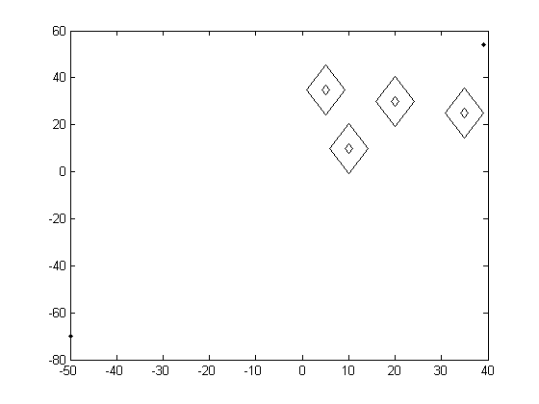
Sampling+Classification
Initial view of solution space topology

Slide 24
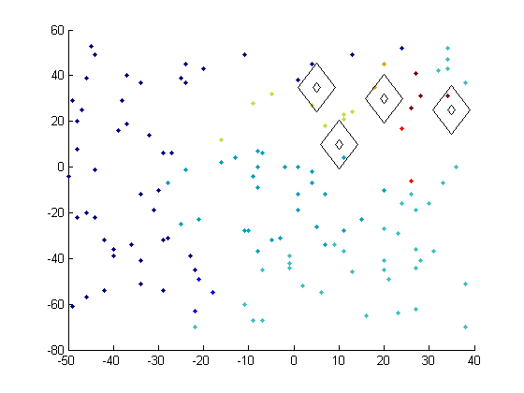
Sampling+Classification

Slide 25
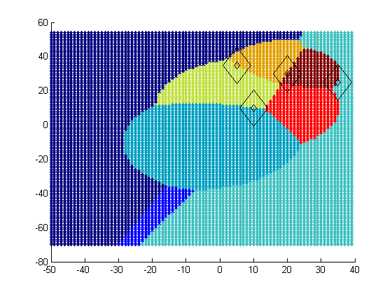
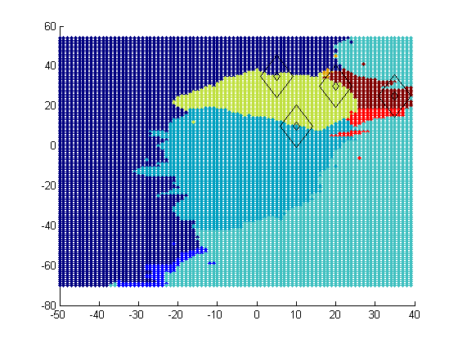
Sampling+Classification
Ideal PS Map
Approximated PS Map

Slide 26
Outline
Motivation
Related Work
Approach
Algorithms
Experiments
TSP
Knapsack
Elevator
Offline Time Investment
Conclusions
Sampling+Classification (SC)
SC+Bias
SC+Active Learning (SC+AL)
Solution Border Estimation (SBE)
Support Vector Machine (SVM)
SVM+SBE
Select from Sampled Solutions (SSS)

Slide 27
SC+Bias - Domain-Based Hints
All the fixed points lie on regional boundaries

Slide 28
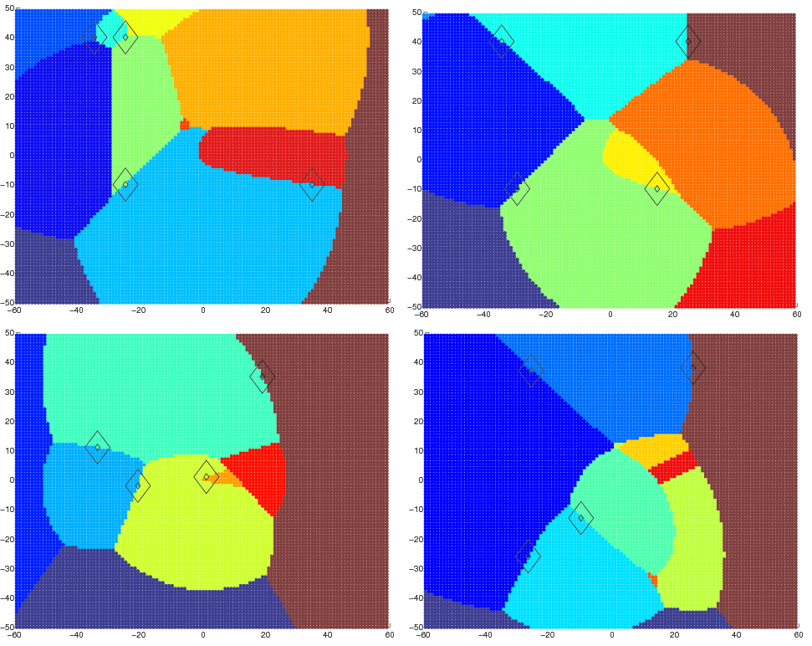
SC+Bias - Domain-Based Hints
All the fixed points lie on regional boundaries

Slide 29
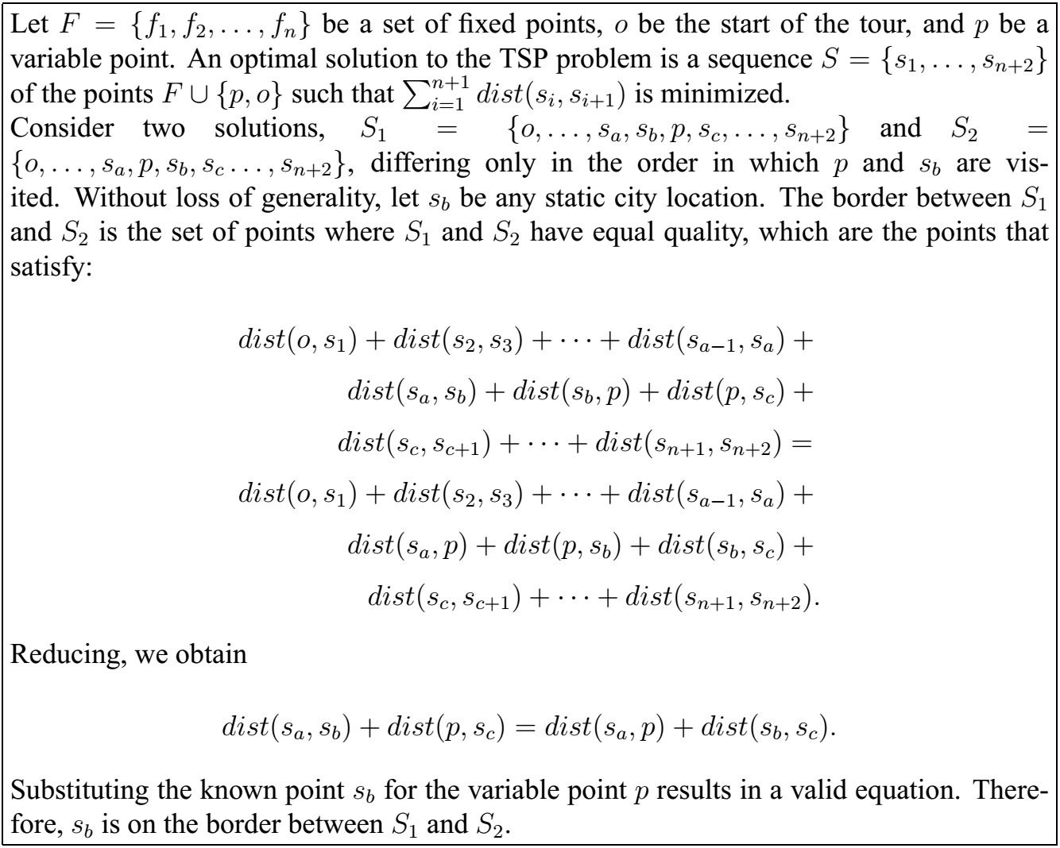
SC+Bias - Domain-Based Hints

Slide 30
SC+Bias
Bias samples toward fixed city locations
City radius
Bias factor

Slide 31
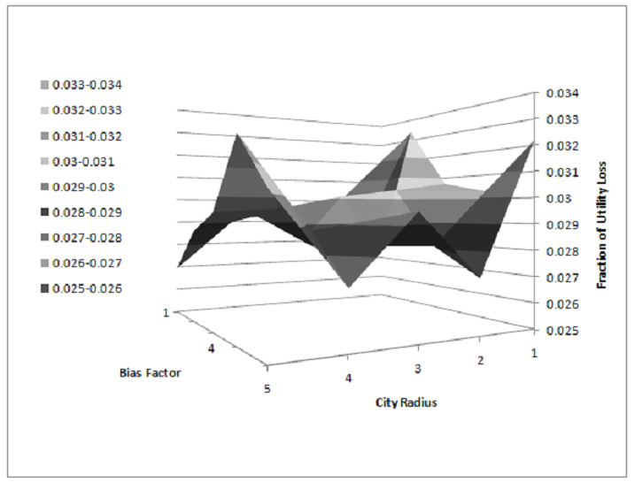
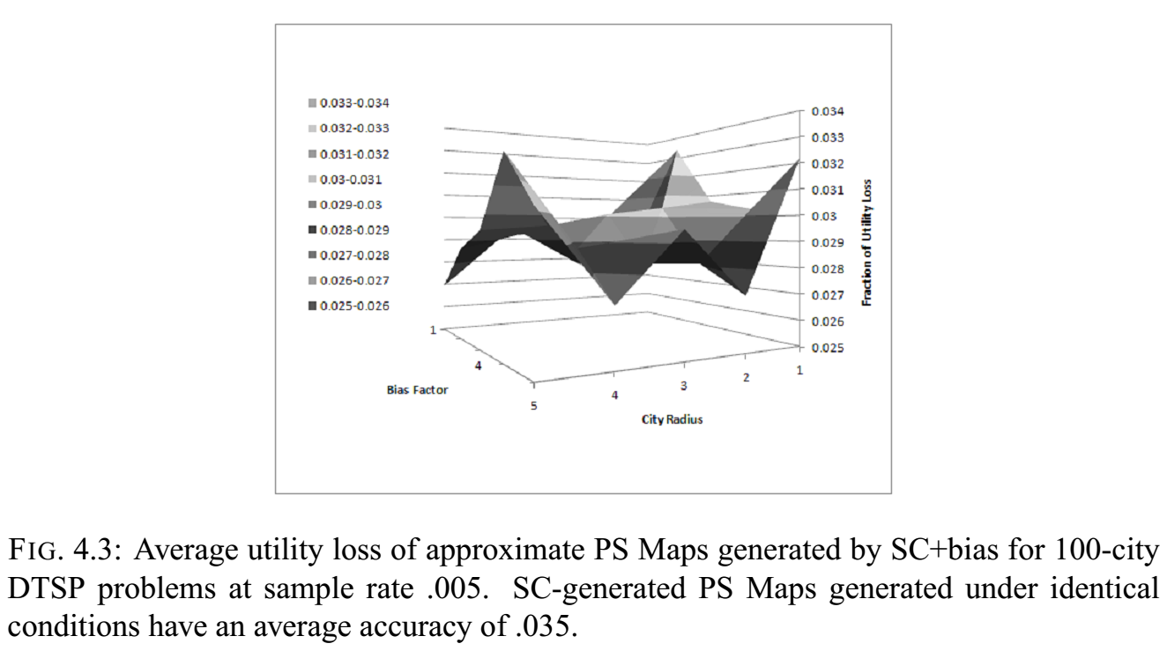
SC+Bias
fraction of utility loss from optimal
bias factor
city radius

Slide 32
Outline
Motivation
Related Work
Approach
Algorithms
Experiments
TSP
Knapsack
Elevator
Offline Time Investment
Conclusions
Sampling+Classification (SC)
SC+Bias
SC+Active Learning (SC+AL)
Solution Border Estimation (SBE)
Support Vector Machine (SVM)
SVM+SBE
Select from Sampled Solutions (SSS)

Slide 33
Sampling & Classification + Active Learning
Determine eventual number of samples
n = sample_rate * total_instances
Create initial sample of solutions of size
n_{i} = alpha * n
For each unknown sample
if polling results in unambiguous result, keep approximate result
else if total samples < n, generate exact solution

Slide 34
Sampling & Classification + Active Learning
ambiguous
landslide
unanimous

Slide 35
Outline
Motivation
Related Work
Approach
Algorithms
Experiments
TSP
Knapsack
Elevator
Offline Time Investment
Conclusions
Sampling+Classification (SC)
SC+Bias
SC+Active Learning (SC+AL)
Solution Border Estimation (SBE)
Support Vector Machine (SVM)
SVM+SBE
Select from Sampled Solutions (SSS)

Slide 36
Solution Border Estimation
Using techniques similar to those used to justify SC+Bias, can solution borders be calculated?
For each combination of two solutions, equate objective functions to determine shape of border

Slide 37
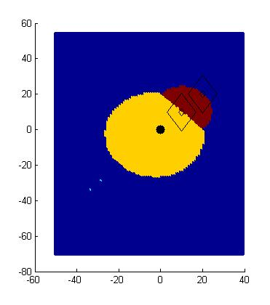
Solution Border Estimation
P0 – P1 – P2 – Px
P0 – P1 – Px – P2
P0 – P2 – P1 – Px
P0 – P2 – Px – P1
P0 – Px – P1 – P2
P0 – Px – P2 – P1
P2
P1
P0
Px?

Slide 38
Solution Border Estimation
P0 – P1 – P2 – Px
P0 – P1 – Px – P2
P0 – P2 – P1 – Px
P0 – P2 – Px – P1
P0 – Px – P1 – P2
P0 – Px – P2 – P1
P2
P1
P0
Px
dist(P0,P1) + dist(P1,P2) + dist(P2,Px) = dist(P0,P1) + dist(P1,Px) + dist(Px,P2)
dist(P1,P2) = dist(P1,Px)
dist(Px,P1) = C

Slide 39
Solution Border Estimation
P0 – P1 – P2 – Px
P0 – P1 – Px – P2
P0 – P2 – P1 – Px
P0 – P2 – Px – P1
P0 – Px – P1 – P2
P0 – Px – P2 – P1
P2
P1
P0
Px
dist(P0,P1) + dist(P1,Px) + dist(Px,P2) = dist(P0,Px) + dist(Px,P1) + dist(P1,P2)
dist(P0,P1) + dist(Px,P2) = dist(P0,Px) +dist(P1,P2)
dist(Px,P2) = dist(Px,P0) + C

Slide 40
Solution Border Estimation
P0 – P1 – P2 – Px
P0 – P1 – Px – P2
P0 – P2 – P1 – Px
P0 – P2 – Px – P1
P0 – Px – P1 – P2
P0 – Px – P2 – P1
P2
P1
P0
Px
dist(P0,P1) + dist(P1,P2) + dist(P2,Px) = dist(P0,Px) + dist(Px,P1) + dist(P1,P2)
dist(P0,P1) + dist(P2,Px) = dist(P0,Px) + dist(P1,Px)
ugly

Slide 41
Solution Border Estimation
P0 – P1 – P2 – Px
P0 – P1 – Px – P2
P0 – P2 – P1 – Px
P0 – P2 – Px – P1
P0 – Px – P1 – P2
P0 – Px – P2 – P1

Slide 42
Solution Border Estimation
P0 – P1 – P2 – Px
P0 – P1 – Px – P2
P0 – P2 – P1 – Px
P0 – P2 – Px – P1
P0 – Px – P1 – P2
P0 – Px – P2 – P1
P2
P1
P0
Px?

Slide 43
SBE Implementation
Unfortunately, solving the equations is not trivial
Developed SBE-trace algorithm to approximate
sample problem instances to find representatives of solutions in the space
for each pair combination
find a problem instance on the boundary using binary search
trace the solution border from the boundary point
for each border intersection
find region to fill in by sending rays in each direction
fill region using fill algorithm

Slide 44
SBE – two solution representatives

Slide 45
SBE – binary search to find border

Slide 46
SBE – binary search to find border
?
?
?

Slide 47
SBE – binary search to find border
?
?
?

Slide 48
SBE – binary search to find border

Slide 49
SBE – binary search to find border
?
?
?
?

Slide 50
SBE – tracing red/blue solution border

Slide 51
SBE – found red/blue solution border

Slide 52
Outline
Motivation
Related Work
Approach
Algorithms
Experiments
TSP
Knapsack
Elevator
Offline Time Investment
Conclusions
Sampling+Classification (SC)
SC+Bias
SC+Active Learning (SC+AL)
Solution Border Estimation (SBE)
Support Vector Machine (SVM)
SVM+SBE
Select from Sampled Solutions (SSS)

Slide 53
Support Vector Machine
SBE-trace only available in two dimensions
Use SVM-based approach to mimic SBE’s border-finding approach
Train SVM with problem instance as observation and solution as label

Slide 54
Outline
Motivation
Related Work
Approach
Algorithms
Experiments
TSP
Knapsack
Elevator
Offline Time Investment
Conclusions
Sampling+Classification (SC)
SC+Bias
SC+Active Learning (SC+AL)
Solution Border Estimation (SBE)
Support Vector Machine (SVM)
SVM+SBE
Select from Sampled Solutions (SSS)

Slide 55
Support Vector Machine+ Solution Border Estimation
Use SBE-trace to find problem instances on solution borders
Augment training instances to constrain the placement of maximum margin plane
via random
sampling
via SBE-trace

Slide 56
Outline
Motivation
Related Work
Approach
Algorithms
Experiments
TSP
Knapsack
Elevator
Offline Time Investment
Conclusions
Sampling+Classification (SC)
SC+Bias
SC+Active Learning (SC+AL)
Solution Border Estimation (SBE)
Support Vector Machine (SVM)
SVM+SBE
Select from Sampled Solutions (SSS)

Slide 57
Select from Sampled Solutions
Initial sample creates a set of known solutions
For each unsolved problem instance, test each known solution and assign the best one
Assumes cost of solution evaluation is not prohibitive

Slide 58
Select from Sampled Solutions
?

Slide 59
Outline
Motivation
Related Work
Approach
Algorithms
Experiments
TSP
Knapsack
Elevator
Offline Time Investment
Conclusions

Slide 60
Evaluation
Three domains
Traveling Salesman Problem
0-1 Knapsack Problem
Elevator Problem
Map approximation
Average fraction of utility loss from optimal
System performance
Comparison to online repair algorithms
Offline computation time vs. online performance

Slide 61
Evaluation: Traveling Salesman Problem
Classic NP-complete problem
Goal is to visit all locations and minimize the distance traveled
99 fixed cities, 1 variable city

Slide 62
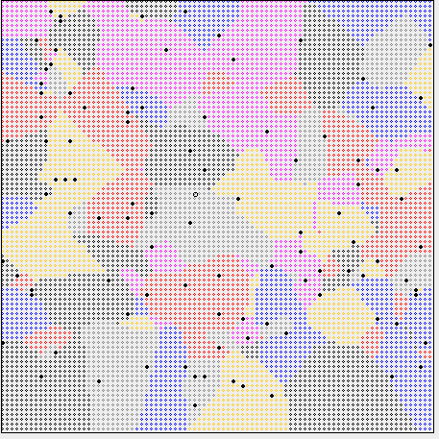
Ideal PS Map – TSP 99 fixed cities, 100x100 region

Slide 63
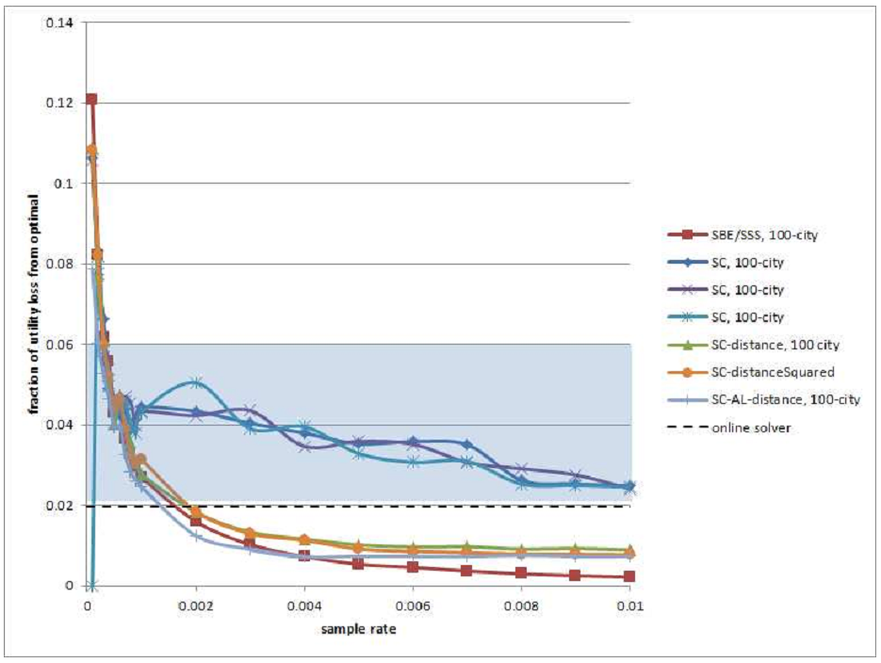
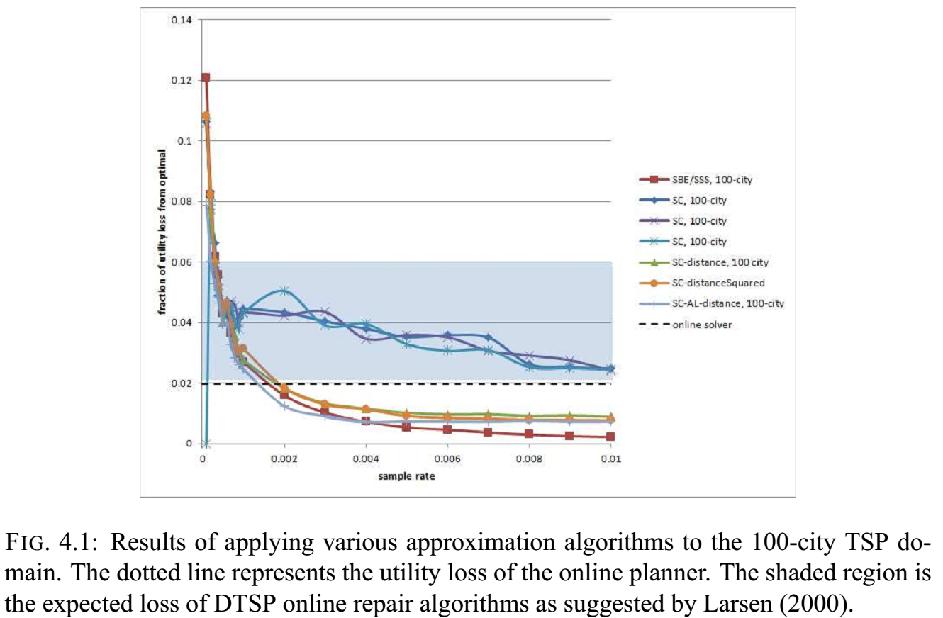
Evaluation: TSP
fraction of utility loss from optimal
fraction of utility loss from optimal
sample rate
sample rate

Slide 64
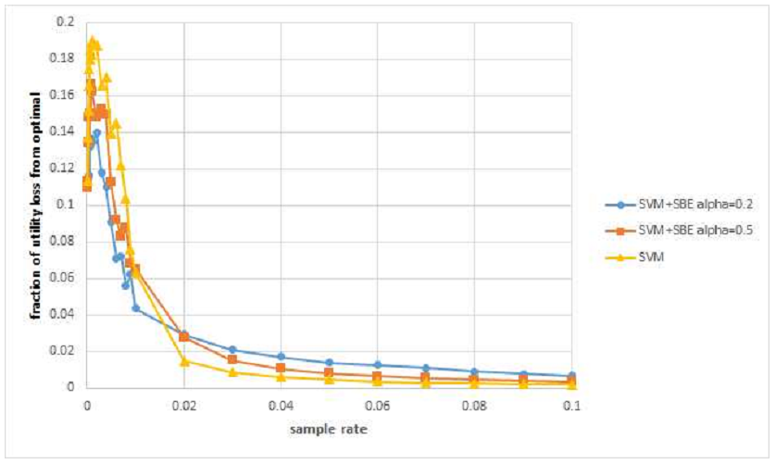
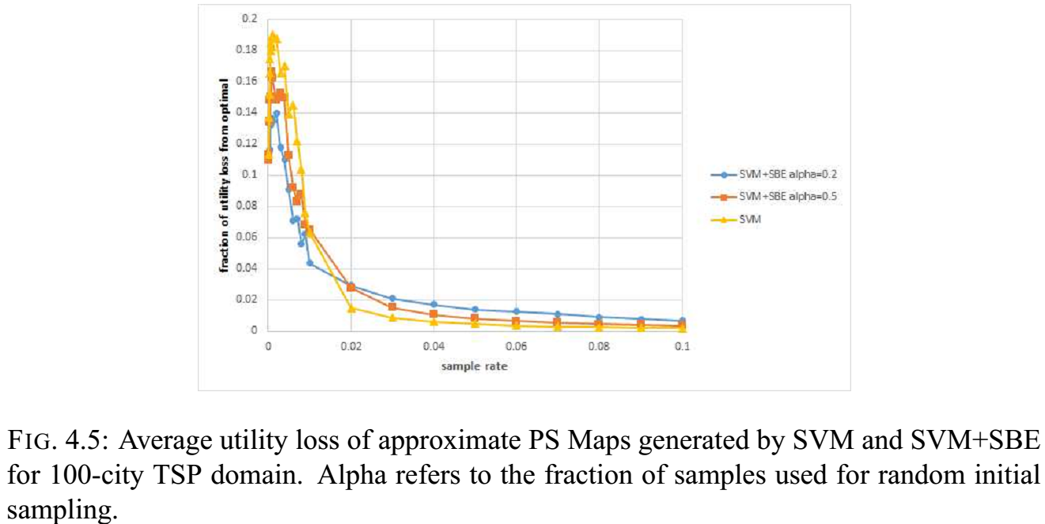
Evaluation: TSP
fraction of utility loss from optimal
sample rate

Slide 65
Evaluation: Knapsack Problem
Classic NP-complete problem
Knapsack is limited by weight
A pool of items of varying weight and value is available
Goal is to maximize the value of the knapsack

Slide 66

Ideal PS Map – Knapsack problem initial slack = 4 dag, new item’s weight and value vary from 1 to 100
1,1
weight
Solutions that do not include the new item
value

Slide 67
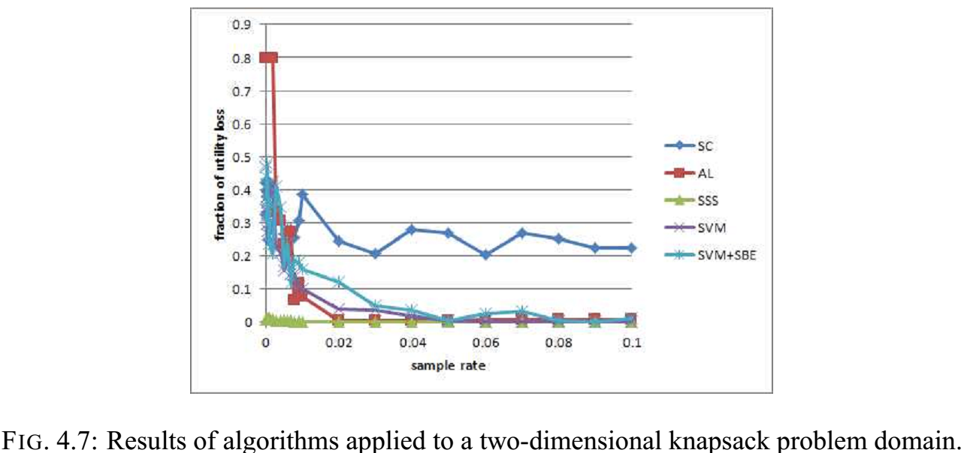
Evaluation: Knapsack Problem
fraction of utility loss from optimal
sample rate

Slide 68
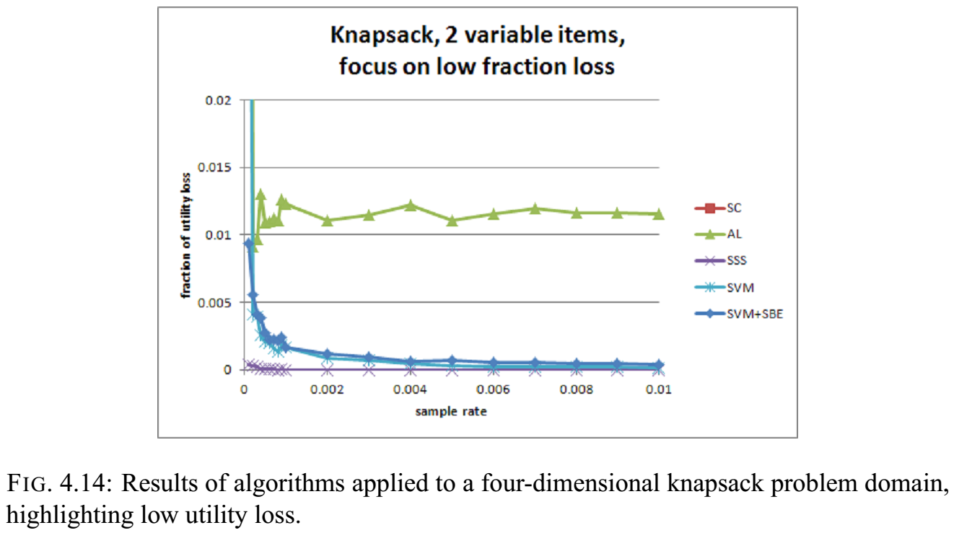
Evaluation: Knapsack Problem
fraction of utility loss from optimal
sample rate

Slide 69
Elevator Problem
ICAPS International Planning Competition problem
Multiple passengers with various starting and destination locations
“Slow” elevators stop at every floor in a specified range of floors
Low cost to move, high cost to stop and start
“Fast” elevators stop at the specified intervals throughout the complete range of floors
High cost to move, low cost to stop and start

Slide 70
Evaluation: Elevator Problem
Solution Space Manipulation
Plan Abstraction
Makes plans applicable to more problem instances
Reduces number of unique plans
Plan Normalization
Reduces number of unique plans
Online Repair Framework
van der Krogt & de Weerdt (2005)
Unrefinement – remove conflicting steps
Refinement – add steps that contribute to goal

Slide 71
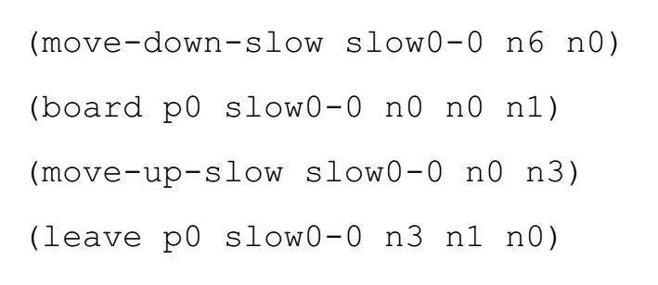
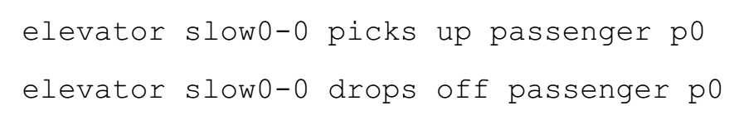
Plan Abstraction

Slide 72
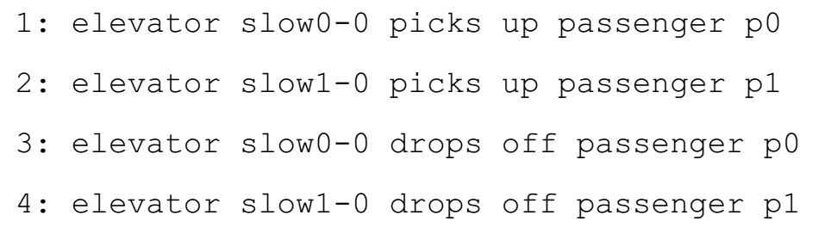
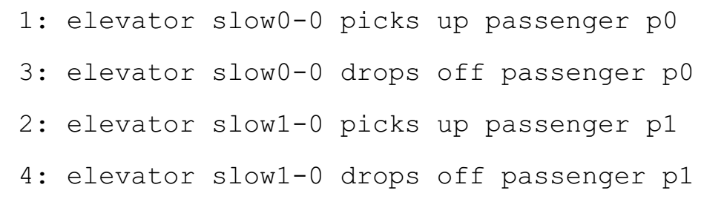
Plan Normalization

Slide 73
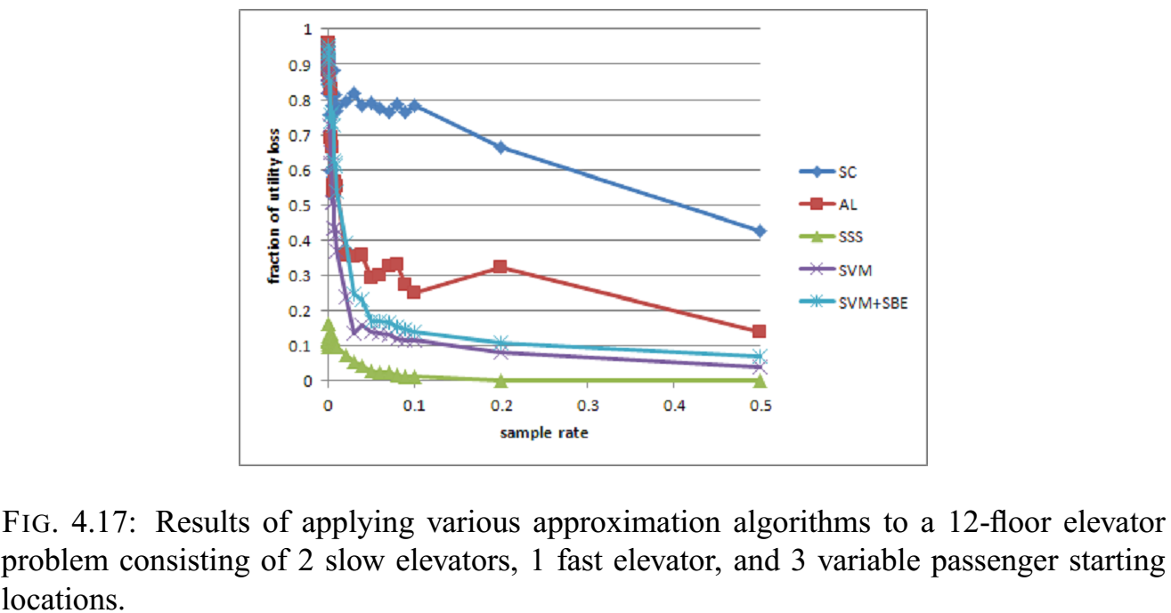
Evaluation: Elevator Problem
fraction of utility loss from optimal
sample rate

Slide 74
Outline
Motivation
Related Work
Approach
Algorithms
Experiments
TSP
Knapsack
Elevator
Offline Time Investment
Conclusions

Slide 75
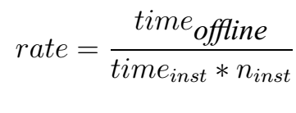
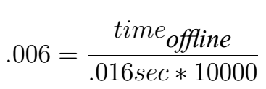
Offline Time Investment
For a two-item knapsack problem using SVM+SBE, offline time is 0.96 seconds

Slide 76
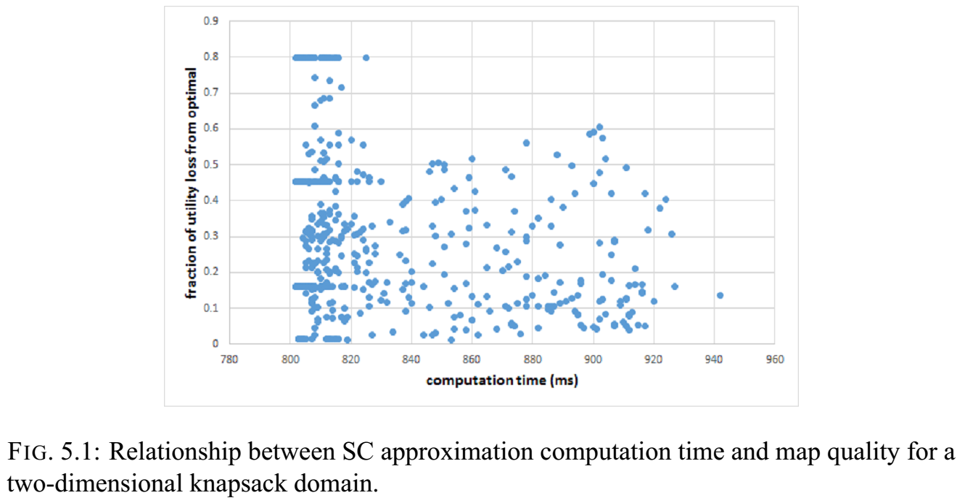
Offline Time Investment
Notes:
Non deterministic results, particularly at low sample rates. Some hint of discretization in SC; very obvious for SSS. Discritization is a function of the specific solutions discovered. Might find addl solutions in AL.

Slide 77
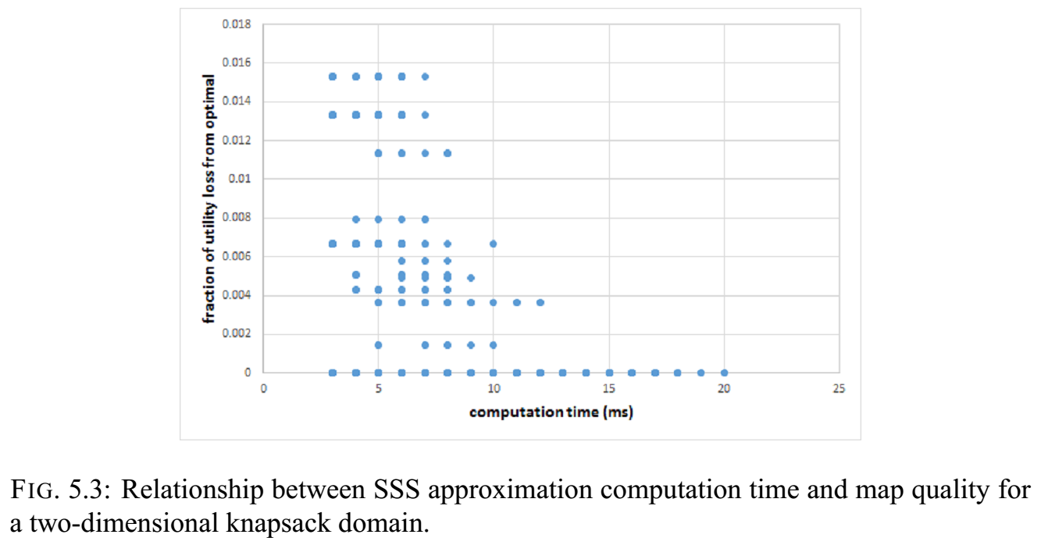
Offline Time Investment
Notes:
Non deterministic results, particularly at low sample rates. Some hint of discretization in SC; very obvious for SSS. Discritization is a function of the specific solutions discovered. Might find addl solutions in AL.

Slide 78
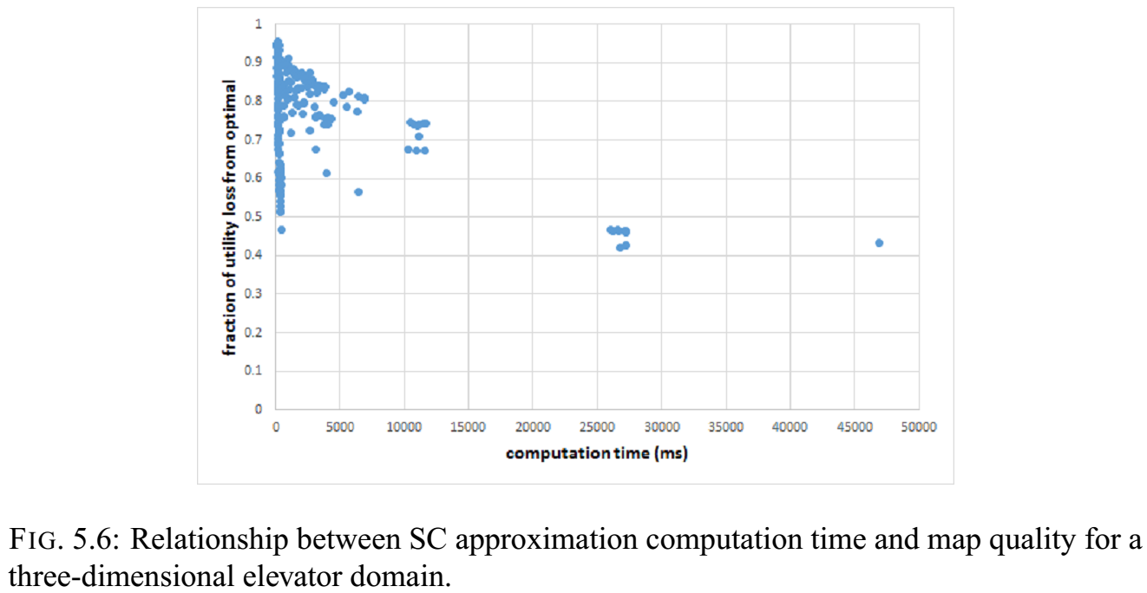
Offline Time Investment
Notes:
Again, high variability, which even leads to lower average loss at low sample rates. Less discretization due to larger number of solutions to be found relative to the number of samples taken

Slide 79
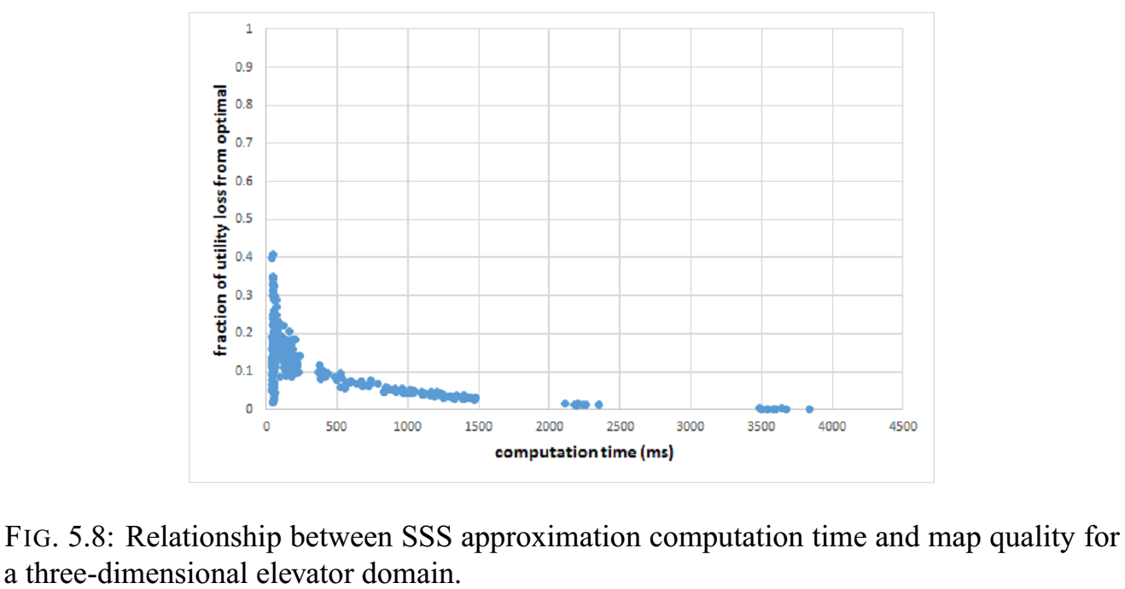
Offline Time Investment
Notes:
Again, high variability, which even leads to lower average loss at low sample rates. Less discretization due to larger number of solutions to be found relative to the number of samples taken

Slide 80
Outline
Motivation
Related Work
Approach
Algorithms
Experiments
TSP
Knapsack
Elevator
Offline Time Investment
Conclusions

Slide 81
Conclusions
Problems domains may have solution spaces consisting of homogeneous regions
Less well behaved solution spaces can be transformed to create homogeneous regions
These regions can be exploited to approximate the solution space
The approximations allow for adaptation that is comparable to online repair

Slide 82
Conclusions (2)
Techniques that explicitly query a set of known solutions or calculate solution borders are more successful than nearest-neighbor based techniques
At low sample rates, targeted sampling contributes to accurate approximations
Algorithm accuracy is sensitive to discovered solutions

Slide 83
Contributions
Representation framework to model and reason about the topological structure of the solutions of related plans
Novel algorithms that exploit solution space structure to generate plan libraries
Techniques to manipulate the structure of the solution space to be favorable for approximation algorithms
Algorithm evaluation by comparison to competing techniques for a set of sample problems

Slide 84
Future Work
Characterization of solution space using fixed characteristics of problem domain
Number of unique solutions
Size of homogeneous solution regions
Indication of necessity of solution abstraction or reindexing

Slide 85
Future Work (2)
Automated Solution Space Manipulation
Plan Abstraction
Plan Normalization
Plan Reindexing

Slide 86
Thank you!
4
0-1-3-2-5-4
0-1-5-4-2-3
0-1-3-2-4-5
0-1-3-5-2-4
0-1-5-3-2-4
0-5-1-3-2-4
0-3-2-4-1-5
0-1-4-2-3-5

Slide 87
Backup

Slide 88
Contributions
Framework to model and reason about the topological structure of the solutions of related plans
Techniques to predict and leverage the effect of problem instance characteristics and attributes on the topological structure of the solution space
Novel algorithms that exploit solution space structure to generate plan libraries, select & configure algorithms, and decompose large problems
Evaluation of these algorithms on a sample problems by comparison to competing techniques

Slide 89
References
Bulka (2009) “Efficient Planning Using Plan Libraries to Capture the Structure of the State Space”
Gopal & Starkschall (2002) “Plan space: representation of treatment plans in multidimensional space”
Hoffman (2001) “Local Search Topology in Planning Benchmarks: An Empirical Analysis”
Hoffman & Nebel (2001) “The FF Planning System: Fast Plan Generation Through Heuristic Search”
Onder & Pollack (1996) “Contingency Selection in Plan Generation”
Kondaris (2008) “Autonomous Robot Skill Acquisition”
Miner (2009) “Rule Abstraction: Understanding Emergent Behavior in Swarm Systems”
Smyth & McKenny (2001) “Competence Models and the Maintenance Problem”
Rosen, et. al. (2005) “Interactively exploring optimized treatment plans”
Trinquart (2003) “Analyzing Reachability within Plan Space”

Slide 90
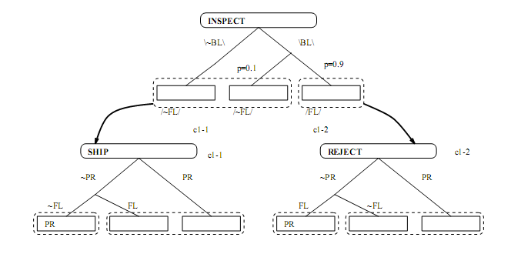
Related Work – Contingency Planning
Onder & Pollock (1996)

Slide 91
Ideal PS Map – Knapsack problem initial slack = 4 dag, new item’s weight and value vary from 1 to 100
1,1
weight
Solutions that do not include the new item
value

Slide 92
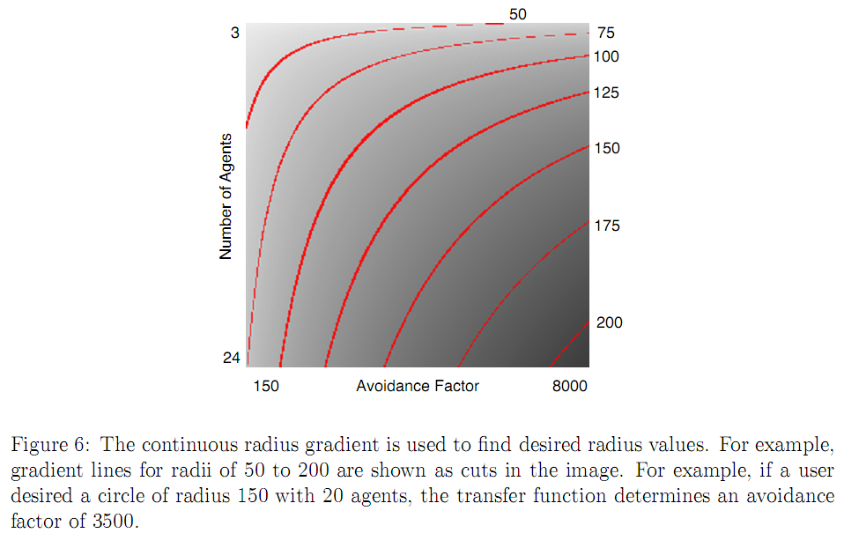

Related Work – Miner (2009)

Slide 93
Motivation
For planning problems in a real-time environment,
A plan library is a means of rapidly adapting to a new environment.
Hypothesis:
Plan Library: Problem space analysis can inform the efficient creation of a plan library.
Problem Space Analysis: A sampling of problem instances and their solutions can lend insight into the underlying structure of the domain.

Slide 94
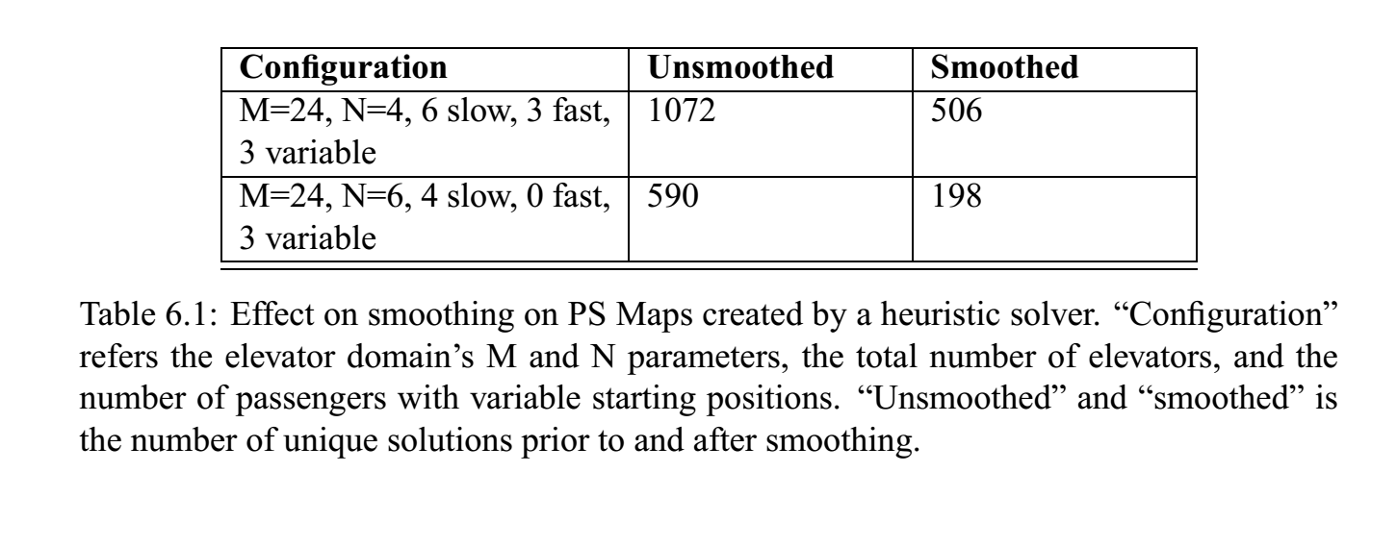
Smoothing
Correction of heuristic solver inaccuracies
Reduction of unique solutions

Slide 96
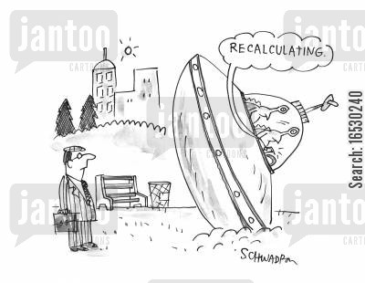
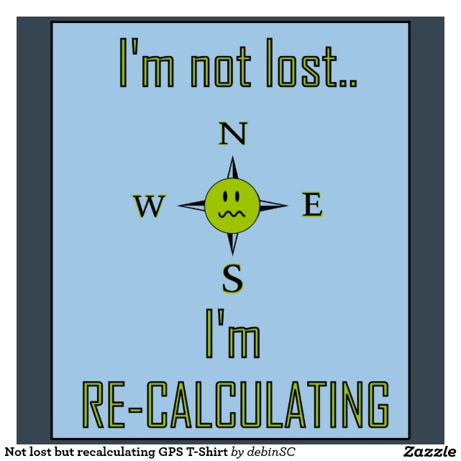
Motivation
http://www.zazzle.com/not_lost_but_recalculating_gps_t_shirt-235701719876135680
http://www.jantoo.com/cartoons/keywords/crash-landings
http://blueskygis.blogspot.com/2011/03/titanic-recalculation.html

Slide 97
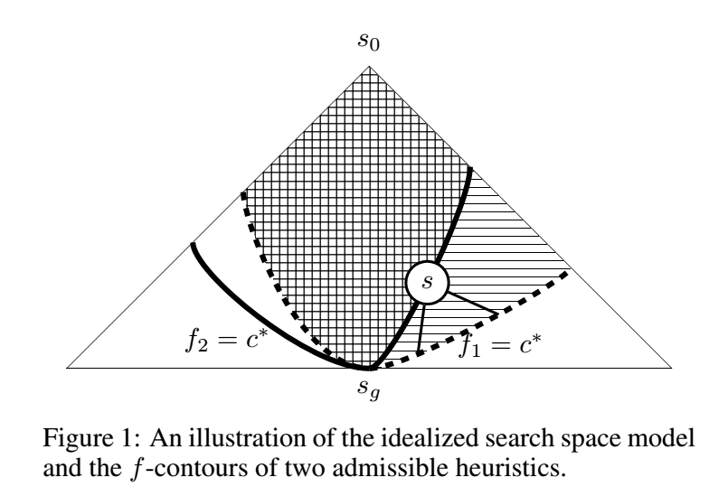
Related Work – Domshlak, et. al. (2010)

Slide 98
Related Work – Boyan & Moore (2000)

Slide 99
Approach: Problem-Solution Map
4
2
1
3
Each point represents a potential location of the fifth city. The color of the point represents the optimal solution for the resulting 5-city TSP.

Slide 100
Summary
Analysis of solution space of test domains
Offline preplanning algorithms to exploit solution space structure
Evaluation of algorithms in test domains
Tradeoff between offline and online time for plan library generation

Slide 101
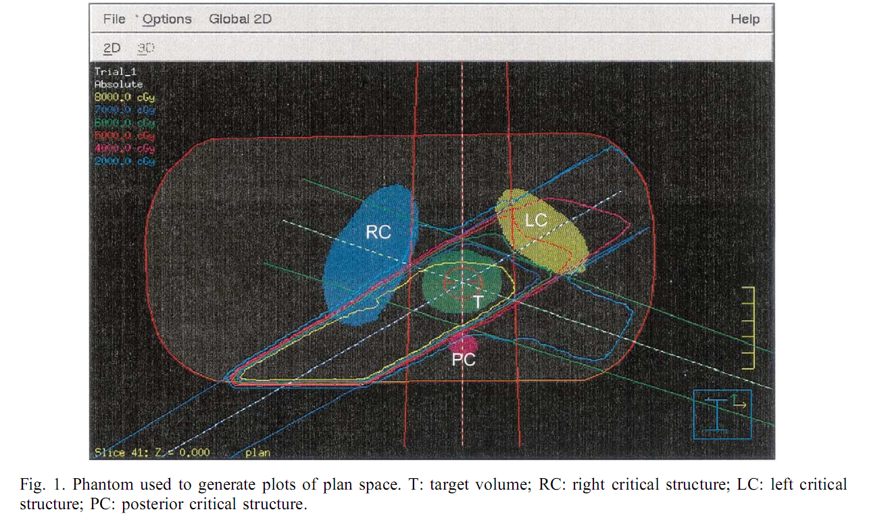
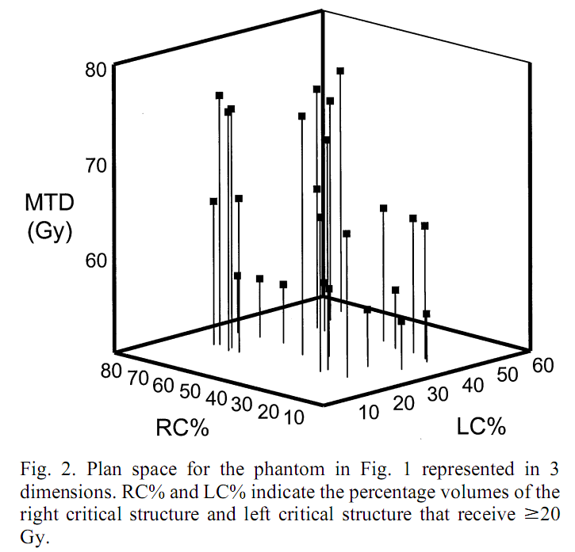
Related Work – Gopal & Starkschall (2002)

